Slide 1
COMP6115 Object Oriented System Analysis and Design DIGITAL CONTENT Session # 2

Slide 2
Learning Objectives
Student able to:
To identify the basic concept of advance topic in object Oriented Analysis and Design
To use the knowledge to develop documentation for object oriented software analysis and design using Unified Modelling Language
To analyze any problem in any software application and find out the alternative solutions using object oriented analysis and design approach

Slide 3

Course : Object Oriented Analysis and Design
Year : 2019
Digital Content
For
Session 2

Slide 4
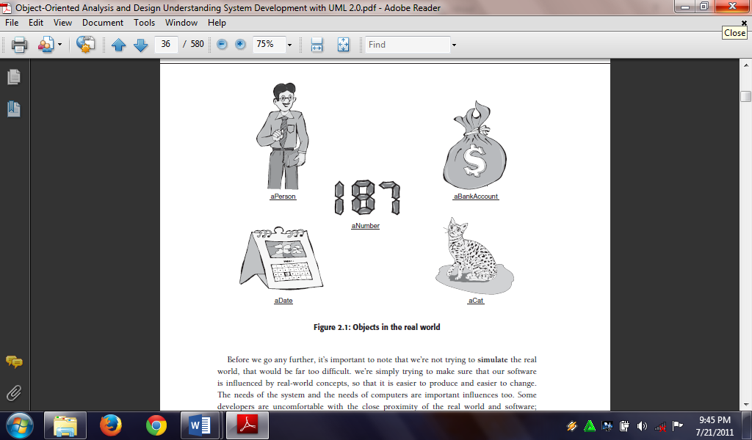
Objects in the real world
Source: O’Docherty (2005)

Slide 5
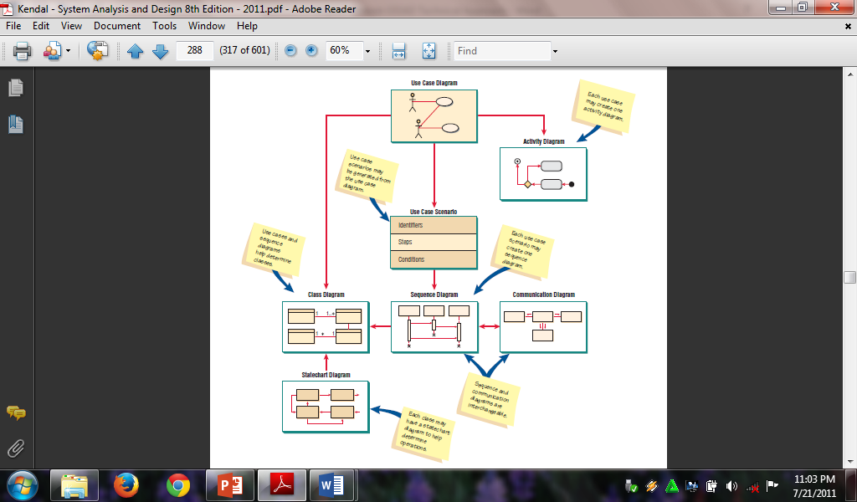
UML Diagramming
Source: Kendall (2011)

Slide 6
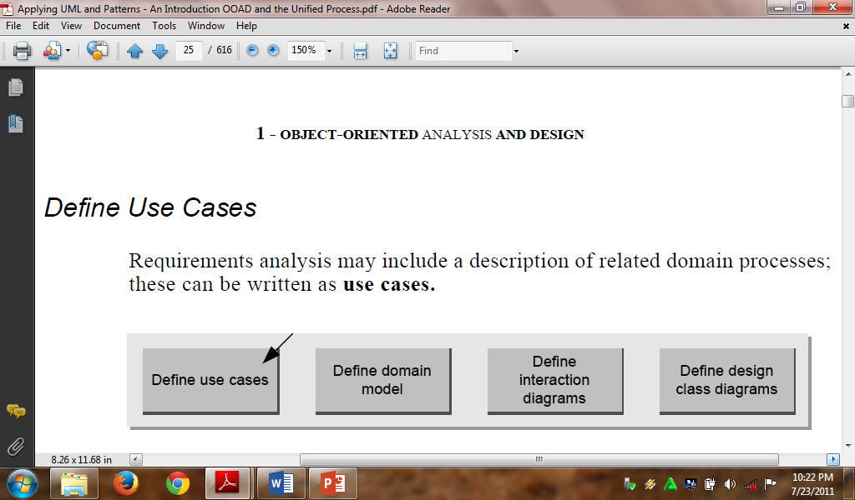
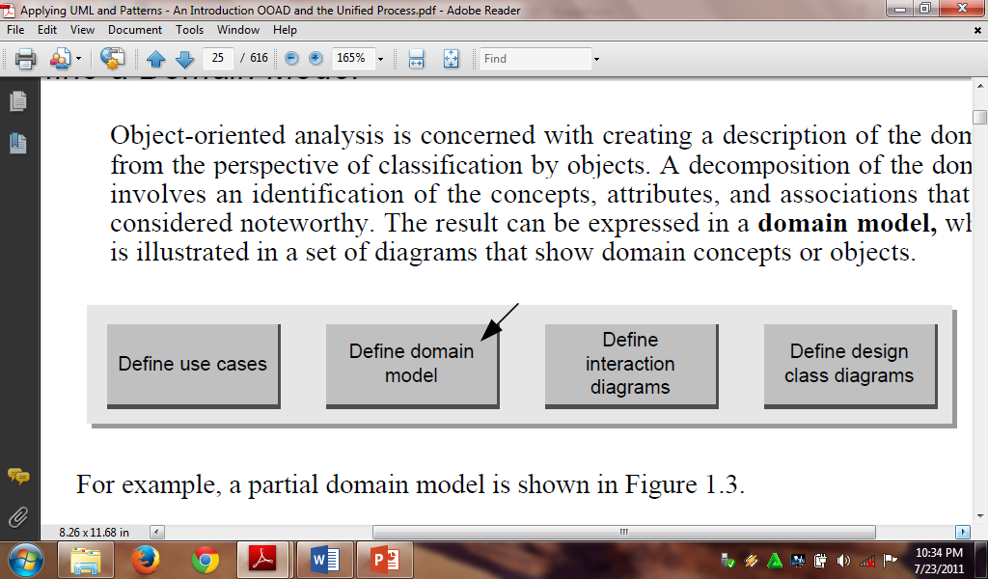
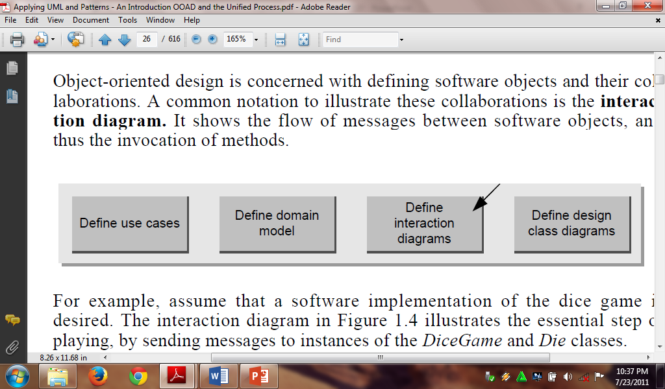
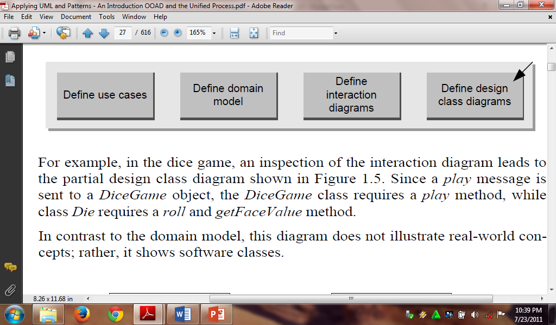
OO Modeling Steps Source: Larman (2008)

Slide 7
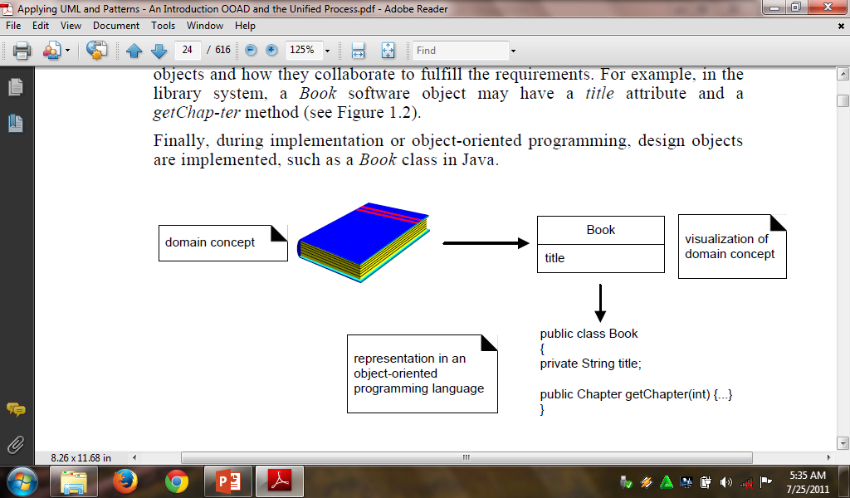
Design Object Implementation Source: Larman (2008)

Slide 8
The Conclusion
Thank you ……….. !!!!

Slide 9
References:
Craig Larman, (2008), Applying UML and Patterns, 3rd edition, Pearson Education Inc., ISBN-13 978-8177589795, Massachusetts-USA
Kenneth E. Kendall & Julie E Kendall (2011), Systems Analysis and Design, 8th Edition, Pearson Education International, ISBN-13 978-0-13-608916-2, New Jersey-USA
Mike O’Docherty, Object-Oriented Analysis and Design Understanding System Development with UML 2.0, ISBN-13 978-0-470-09240-8, West Sussex-England
Roberta M. Roth, Allan Dennis, Barbara Haley Wixom, (2013), Systems Analysis and Design, 5th Edition, John Wiley Sons Inc,, ISBN 987-1-118-09374-0, Singapore

Slide 10
Acknowledgement
This digital content has been developed by the Faculty Member of SCS in Advanced Software Engineering to give an illustration of the Object Oriented System Analysis and Design.

